Slide 1

Lecture – 3.2 JAVA: Operators
Afsara Tasneem Misha
Lecturer
Department of CSE
Daffodil International University

Slide 2
Contents
Basic Operators in JAVA

Slide 3
Basic Operators in Java
Arithmetic Operators
Relational Operators
Bitwise Operators
Boolean Logical Operators
Conditional Operator ( ? : )

Slide 4
1. Arithmetic Operators
Addition +
Subtraction -
Multiplication *
Division /
Remainder %
Increment ++
Addition Assignment +=
Subtraction Assignment -=
Multiplication Assignment *=
Division Assignment /=
Modulus Assignment %=
Decrement --

Slide 5
**Arithmetic Assignment Operators
There are many assignment operators, including the following:
Operator
+=
-=
*=
/=
%=
Example
x += y
x -= y
x *= y
x /= y
x %= y
Equivalent To
x = x + y
x = x - y
x = x * y
x = x / y
x = x % y

Slide 6
**Increment/decrement Operators
Preincrement:
i = ++n;
Predecrement:
i = --n;
Postincrement
i = n++;
Postdecrement
i = n--;

Slide 7
2. Relational Operators
> greater than
>= greater than or equal to
< less than
<= less than or equal to
= = equal to
!= not equal to
The outcome of these operations is a boolean value.
= = , != can be applied to any type in java.
Only numeric types are compared using ordering operator.

Slide 8
3. Bitwise Operators
~ Bitwise unary NOT
& Bitwise AND
| Bitwise OR
^ Bitwise XOR
>> Shift Right
>>> Shift Right zero fill
<< Shift left
& = Bitwise AND Assignment
|= Bitwise OR Assignment
^= Bitwise XOR Assignment
>>= Shift Right Assignment
>>>= Shift Right zero fill Assignment
<<= Shift Left Assignment

Slide 9
Bitwise Operator
A | B | A | B | A & B | A^ B | ~A
0 | 0 | 0 | 0 | 0 | 1
0 | 1 | 1 | 0 | 1 | 1
1 | 0 | 1 | 0 | 1 | 0
1 | 1 | 1 | 1 | 0 | 0

Slide 10
4. Boolean Logical Operators
& Logical AND
| Logical OR
^ Logical XOR
|| Short-circuit OR
&& Short-circuit AND
! Logical unary NOT
&= AND Assignment
|= OR Assignment
^ = XOR Assignment
= = Equal to
!= Not equal to
?: Ternary if-then-else

Slide 11
Boolean Logical Operator
The logical boolean operators &, | and ^ operates in the same way that they operate on the bits of integer.
a | b | a & b | a | b | a ^ b | !a
true | true | true | True | false | false
true | false | false | true | true | false
false | true | false | true | ture | true
false | false | false | false | false | true

Slide 12
5. Conditional Operator ( ? : )
(expression) ? value if true : value if false
(a > b) ? a : b;
it is an expression which returns one of two values, a or b. The condition, (a > b), is tested. If it is true the first value, a, is returned. If it is false, the second value, b, is returned.

Slide 13
Conditional Operator is equivalent to if ..else
if (a > b) {
max = a;
}
else {
max = b;
}
max = (a > b) ? a : b;

Slide 14
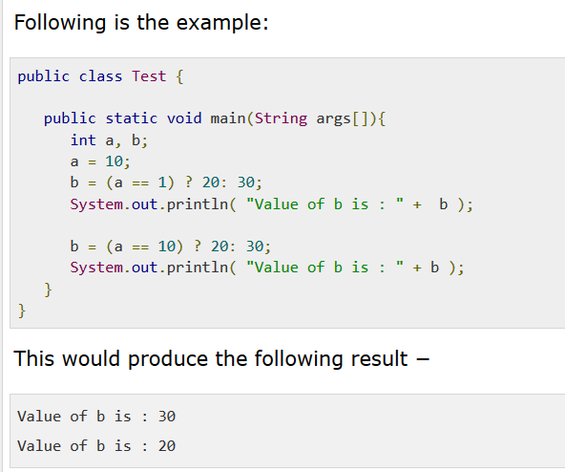

Slide 15
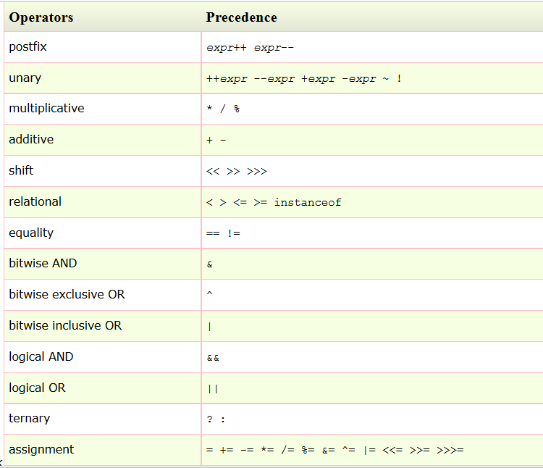
Operator Precedence

Slide 16
Java Control Statements

Slide 17
Java Control Statements
Selection Statements
if
switch
Iteration Statements
For loop
While loop
do-while loop
Jump Statements
Break
Continue
return

Slide 18
Exercise
Check whether a number is even or odd.
Check whether a number is positive or negative.
Check whether a year is LEAP YEAR or Not.
Find out the maximum value of three numbers.
Make a simple calculator.

Slide 19

Thank you!

